Slide 1
Welcome to MCC’s

Slide 2
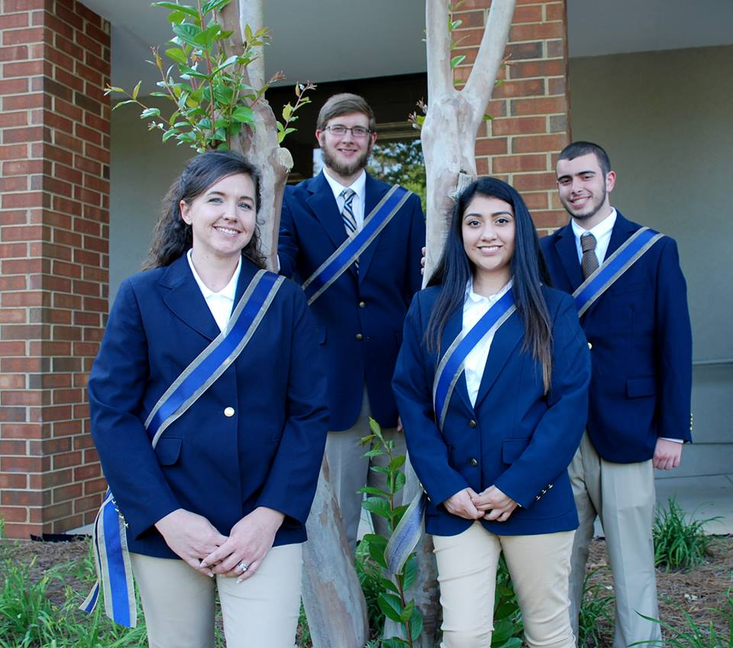
Admissions
Student Accounts
Financing your Education
Placement Testing
Registration
Student Support
Student’s Role
Student’s Resources

Slide 3
Admissions

Slide 4
Checklist for Admissions and Enrollment
Complete Residency Determination Service (RDS)
Submit your online MCC application
Request your official high school or adult high school equivalency transcript
Request official transcript(s) from other colleges you have attended so your previous credits can be evaluated for possible transfer credit.
Activate your student online account and begin accessing your Self Service and student email (TrailMail) accounts. It’s important to check these accounts frequently for any updates concerning admissions and financial aid.
Placement testing (if needed)
Apply for Financial Aid
Meet with your program advisor and register for your courses
Pay your tuition and get your picture taken for your student ID card and parking sticker

Slide 5
Student Accounts

Slide 6
MCC TechTrail A portal to your online student accounts
To begin exploring your online student accounts, you must set your username and password which will be used for all your accounts.
Just click on the
MCC TechTrail icon at the top of our homepage where you will find
Account Activation.
After activating your account, you can begin accessing all your student accounts such as
Self Service and TrailMail.

Slide 7
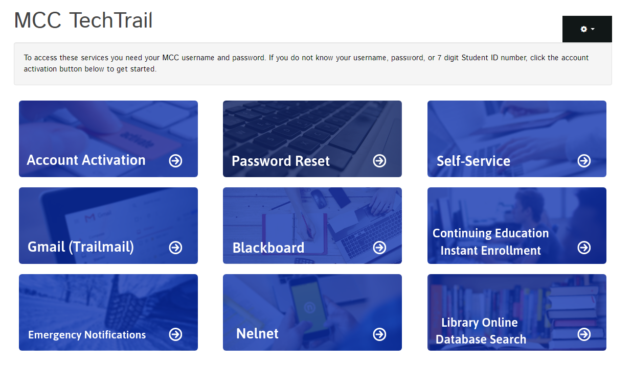

Slide 8
Self Service
Self Service is a great way to monitor your status regarding admissions, registration and financial aid.
Through Self Service
View requirement documents for admissions & financial aid
Register for courses
View your grades
Monitor progress towards completing program requirements
Obtain an unofficial transcript
Pay for tuition & fees
View your financial aid status
Pay for tuition & fees
Trailmail
(Student email account)
Students are assigned a student gmail account and are encouraged to check their email regularly for any updates pertaining to:
Admissions updates
Reminders about registration and tuition payment
Financial aid updates
After registration, you should also expect emails from your instructors concerning any assignments or deadlines.

Slide 9
Financing Your Education
FAFSA
Scholarships
Payment plan

Slide 10
Financing Your Education
Free Application for Federal Student Aid (FAFSA)
Student are encouraged to apply early at www.fafsa.gov.
After submitting the application, students will begin receiving notifications through their student email account concerning the steps to complete their financial aid file.
MCC Foundation Scholarships
Students will be notified of their scholarship eligibility after submitting their FAFSA.
Outside scholarships
Students receiving outside scholarship should contact the Business Office at MCC.
Sponsorships
Students being sponsored by employer or outside agencies should contact the Business Office at MCC about requirement documentation.
Nelnet Payment plan
MCC has a payment plan through Nelnet. Students should aware of the additional cost as well as the limited enrollment periods.
Self Pay Students
Payment can be made directly to our Business Office or through your Self Service account.

Slide 11
Placement Testing

Slide 12
Math & English Placement
Placement
College Level English
College Level Math
RISE Placement (EdReady)
Schedule a testing session with Counseling Office
Enroll in Developmental Math/English
Foundational Department
To obtain an Official Copy of your Test Results
See the Registrar’s office

Slide 13
Registration
Advising
Registration
Payment
Student ID

Slide 14
Students are assigned an advisor based on their program of study. When the registration period opens, students are encouraged to contact their advisor to schedule an advising appointment to discuss academic plan and course offerings.
Students may register after meeting with their advisors.
First time MCC students should register with their advisor or enrollment staff in Student Services for their first term of enrollment.
Going forward, after meeting with your advisor, students can register themselves through Self Service.

Slide 15
Tuition payment due
Payment deadlines will be set each semester. It is the student’s responsibility to make sure tuition charges are paid to avoid being removed courses.
FAFSA or MCC Scholarship Recipients
If you have received your award letter through your Self Service account, then you will follow the procedures set forth through the Financial Aid office.
If you have NOT received your award letter, you need to make sure all required documents have been submitted to the Financial Aid Office. Tuition charges will the student’s responsibility until the award letter is received.
Tuition rate per credit hour
In-state = $76
Out-of-state = $238
Recipients of 0utside scholarships or sponsorships must provide requirement documents by the payment deadline.

Slide 16
Student Support
Counseling
Tutoring Services

Slide 17
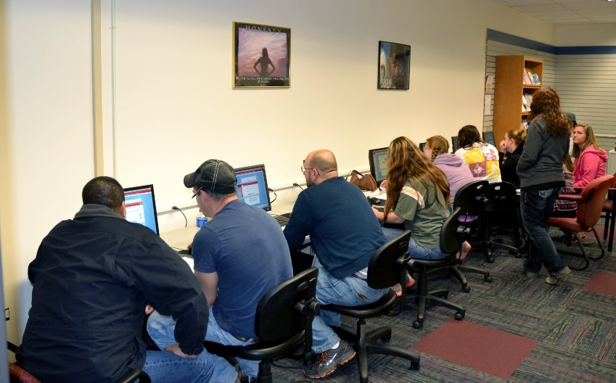
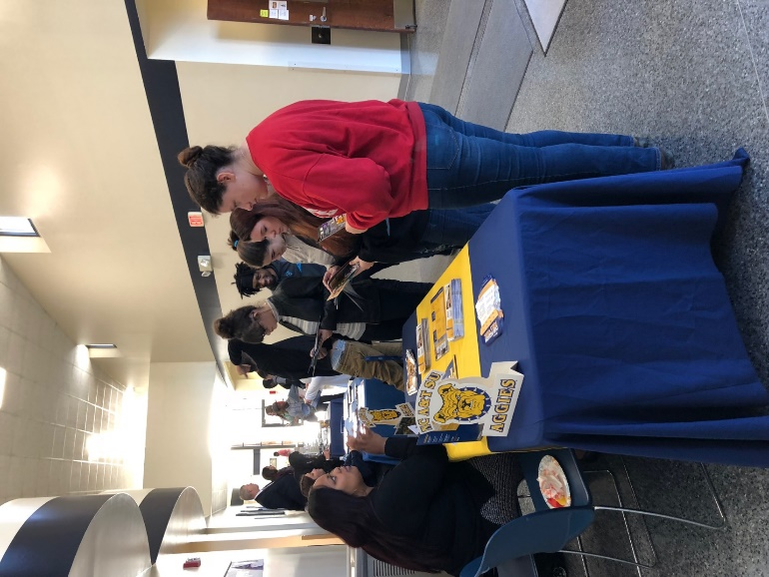
Student Support
Study Skills Seminars
ACA courses
Time management
Study for exams
Career exploration
College research
ENG-114 courses
Resume building
Mock interviews
ADA Services
Section 504
Disability Services
Counseling Services
Academic, Career, Personal
Links to campus resources or to community resources
At-risk case management
Tutoring Services
ACE - Online tutoring access
Face-to-face tutoring

Slide 18
Student Resources

Slide 19
Student Resources
Academic Counseling Exchange (ACE)
Online tutor services
Face-to-face tutors
Math
English
CATS Lab
Computer lab for student use
Distance Learning support
Library and Library Research Tools
MCC TechTrail for direct access to online resources
Student Services
Admissions and Enrollment
Financial Aid and Veterans Offices
Advisors for academic and extraculuar activites

Slide 20
Student Life
Get Involved !
Have some fun!

Slide 21
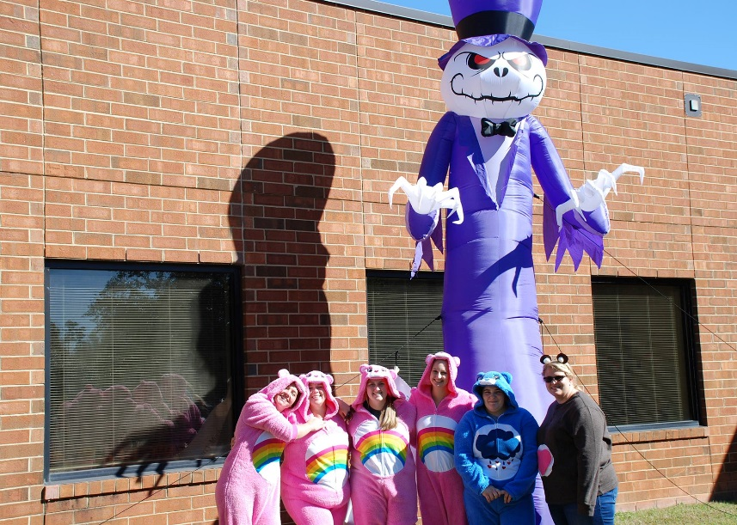
SGA and Student Club Activities
Halloween
Spootakular
Spring Fling
Polar Volleyball Tournament
Human Services Club
Outreach project

Slide 22
Student Role
What you should know

Slide 23
Student Role
Follow-up with admissions & financial aid
Check email/mail communications
Provide all required documentation
Set-up your student accounts
Self-Service, Trailmail, Blackboard
Meet with Program Advisor
Talk about goals and plan your schedule
Register and pay for courses
Order books or other course materials ON time
Save/print/keep a copy of your course syllabus and calendar for each course
Attend classes (review attendance policy)
You could be dropped for excessive absences
Complete assignments, quizzes, exams, projects ON time
Monitor your course performance
Keep up communication with your instructors/advisor
EARN your grades!
When in doubt ask, ask, ask

Slide 24
Questions
Who can you contact?

Slide 25
Admissions Tavia Housley 910-898-9612 housleyt@montgomery.edu
Business Office
Jessica Blanchard
910-898-9633
blanchardj@montgomery.edu
Financial Aid Tammy Owens 910-898-9614 owenst@montgomery.edu
Counseling/Testing Diana Sanchez 910-898-9619 sanchezd@montgomery.edu
Student Life & Recruitment Jessica Latham 910-898-9617 lathamj@montgomery.edu
Distance Learning
Alex Linnell 910-898-9646 linnella@montgomery.edu
Registration Karen Frye 910-898-9620 fryek@montgomery.edu

